Slide 1
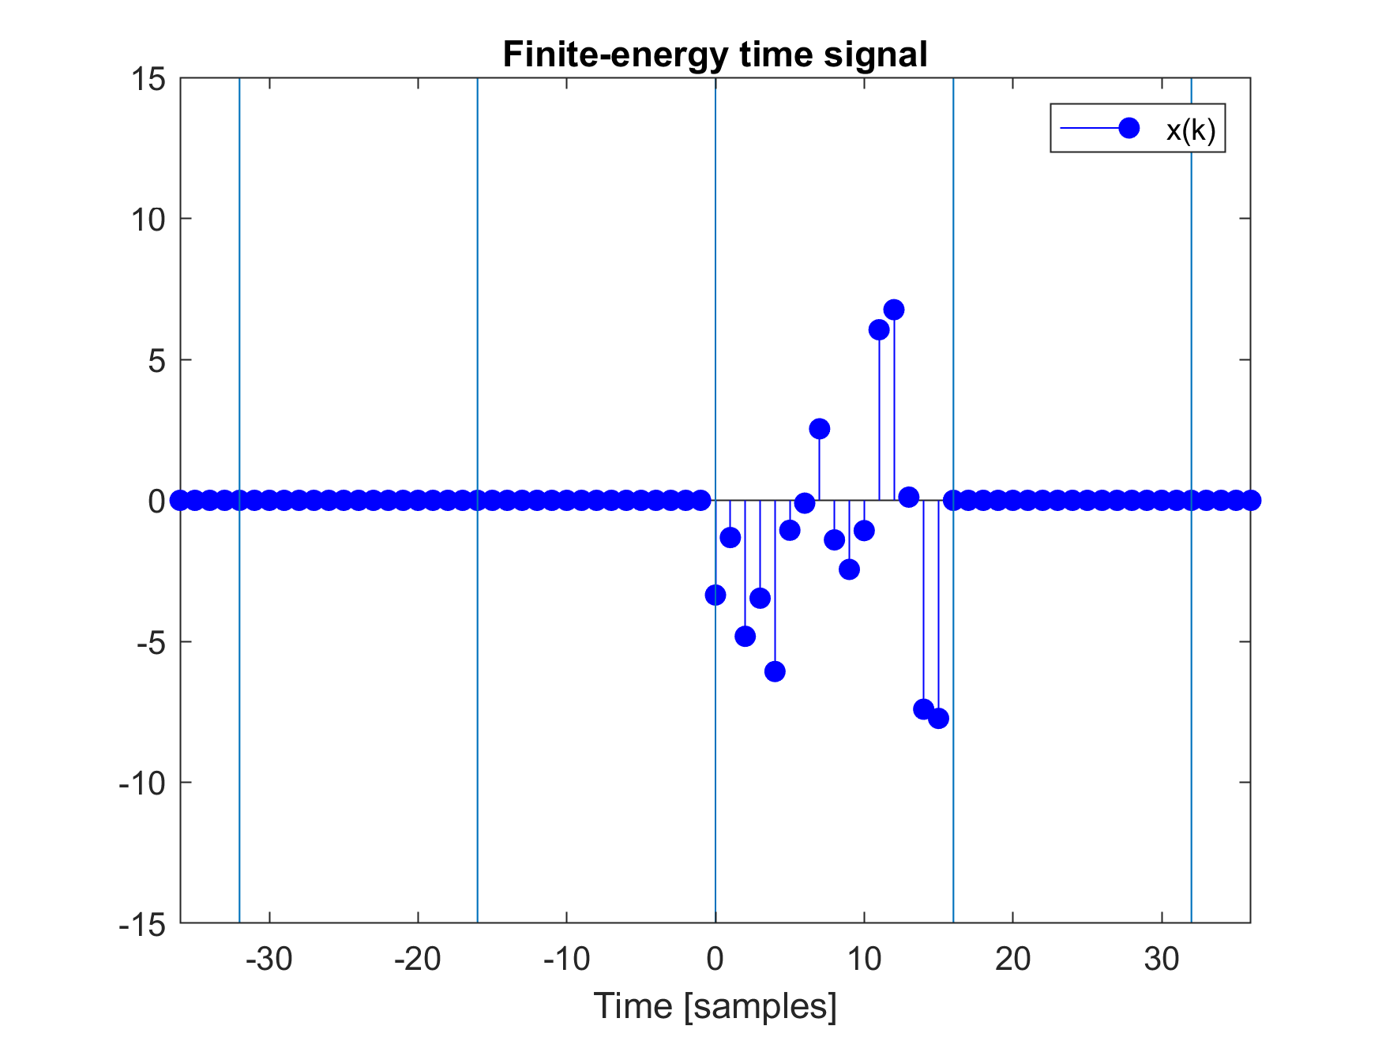
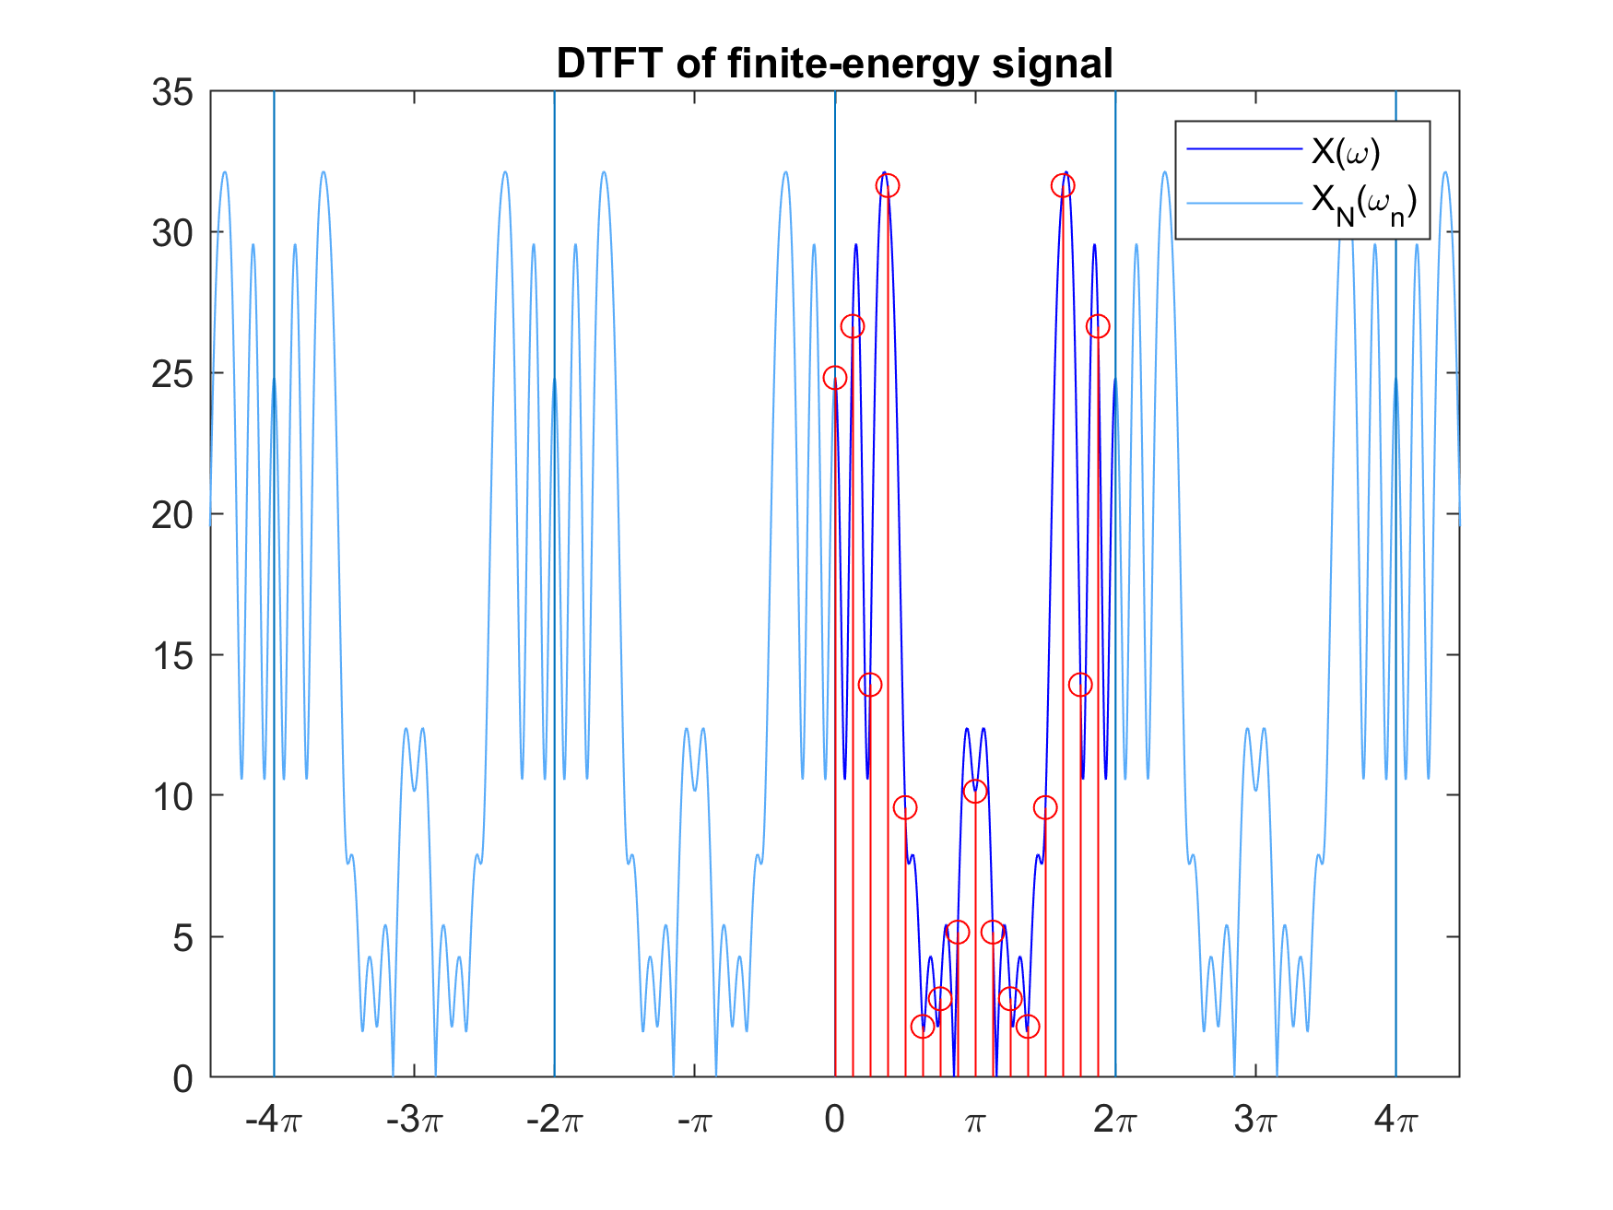
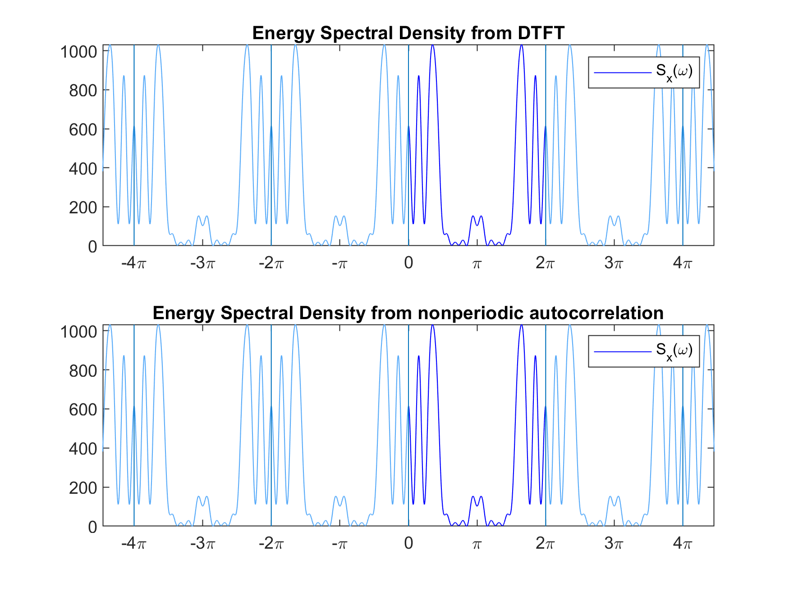
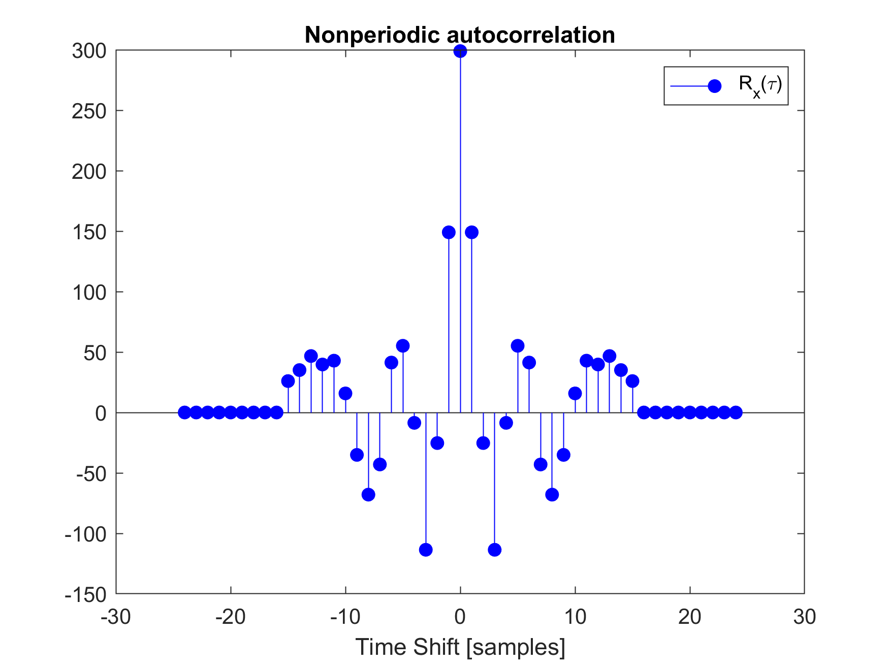
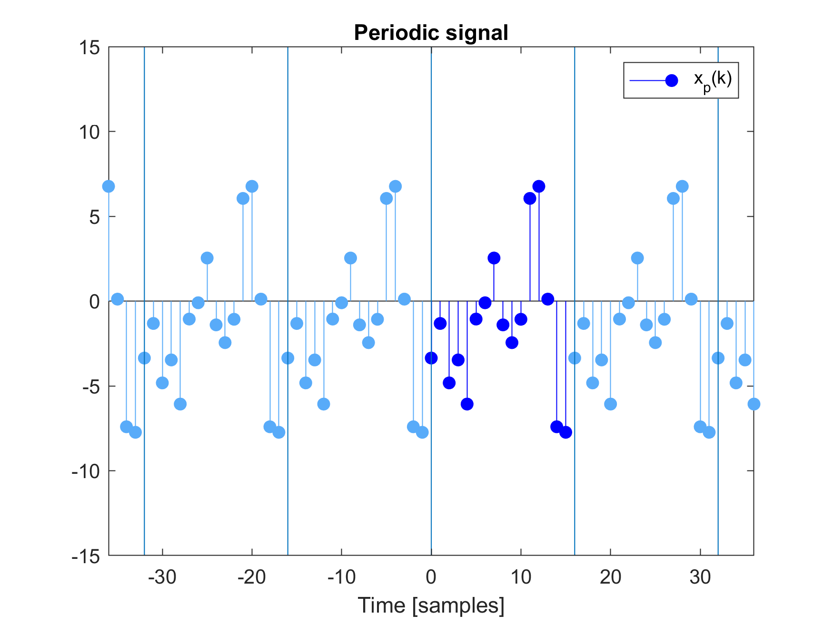
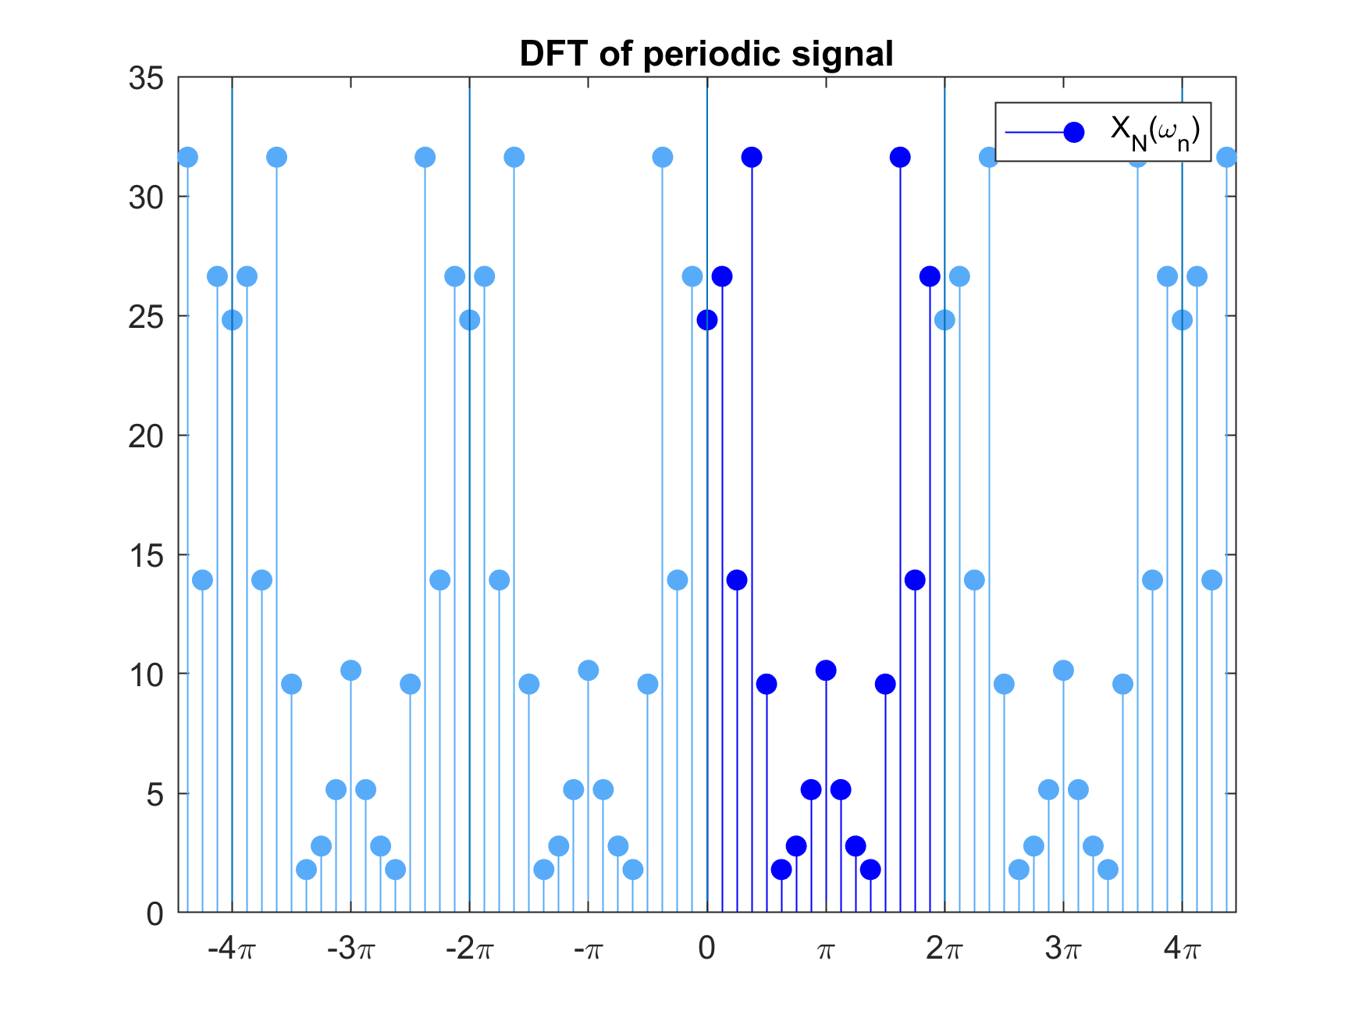
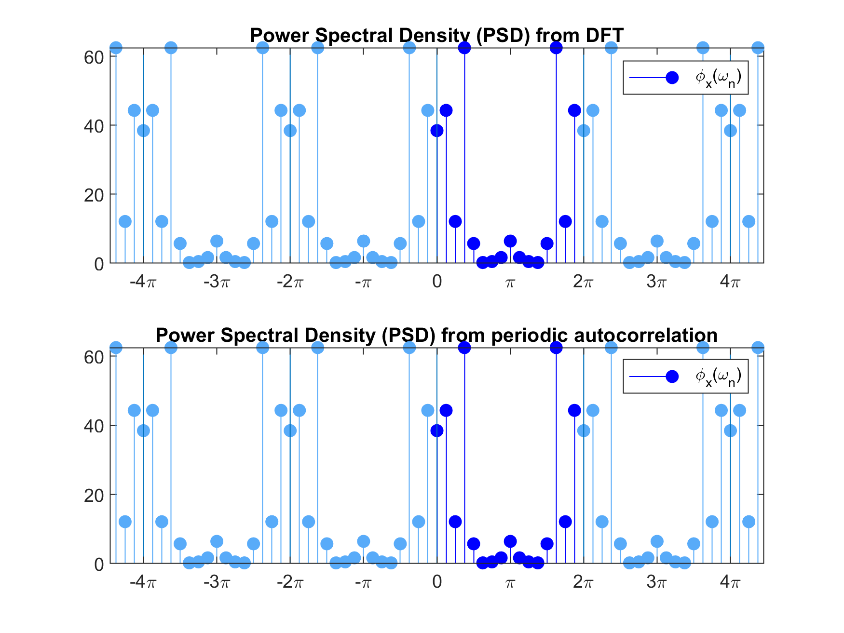
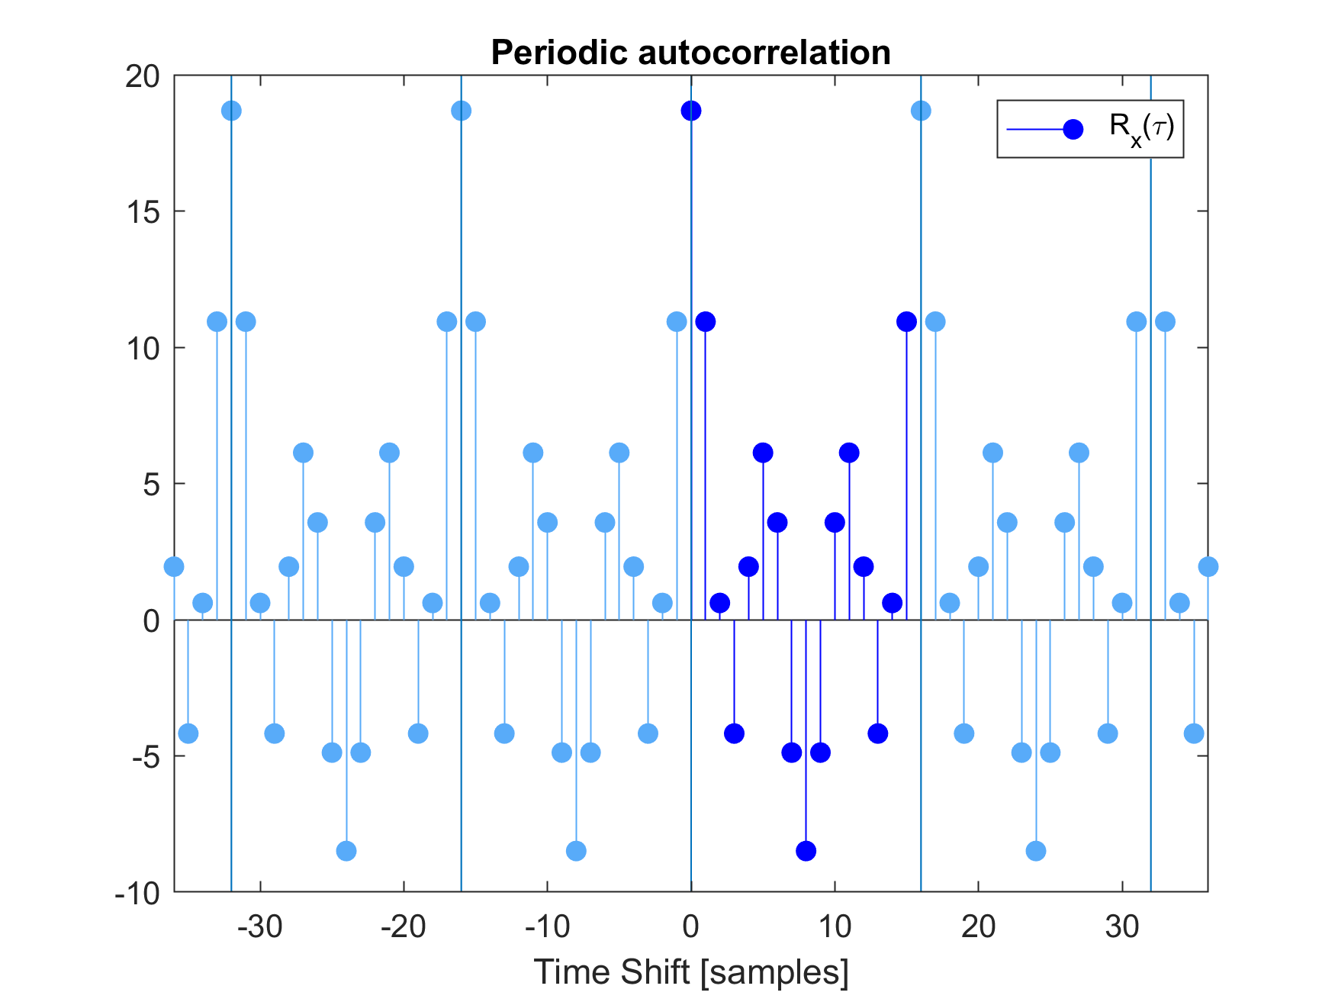
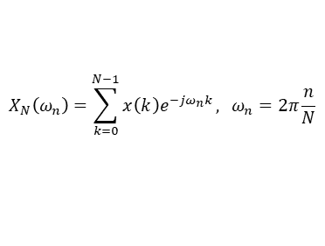
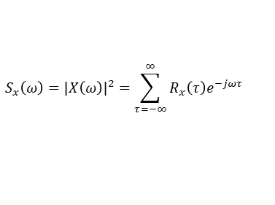
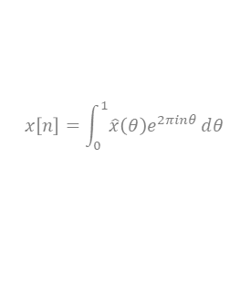
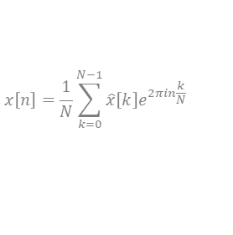
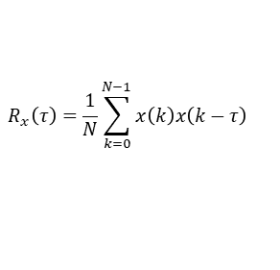
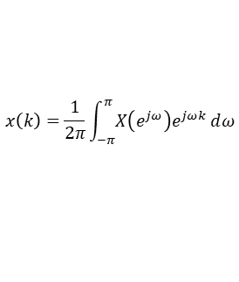
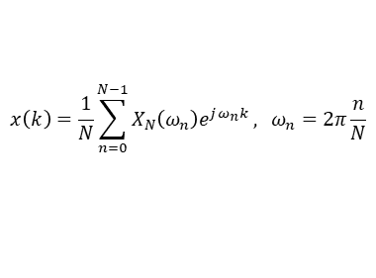
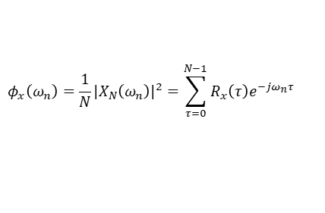
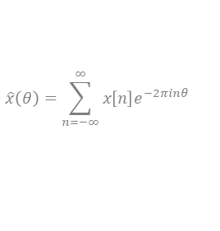

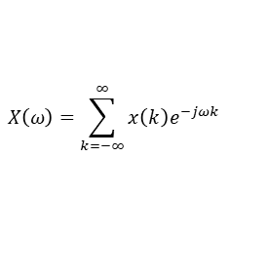
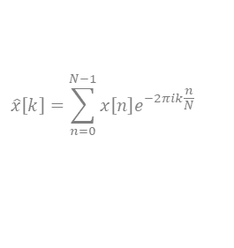
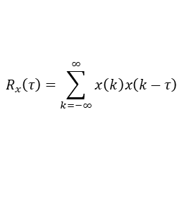
Nonperiodic Time Domain Signal
Discrete Time Fourier Transform (DTFT)
Energy Spectral Density
Nonperiodic Autocorrelation
$$x\left[n\right]=\int_{0}^{1}{\hat{x}\left(θ\right)e^{2πinθ}ⅆθ}$$
$$\hat{x}\left(θ\right)=\sum_{n=−∞}^{∞}{x\left[n\right]e^{−2πinθ}}$$
$$x\left(k\right)=\frac{1}{2π}\int_{−π}^{π}{X\left(e^{jω}\right)e^{jωk}ⅆω}$$
$$X\left(ω\right)=\sum_{k=−∞}^{∞}{x\left(k\right)e^{−jωk}}$$
$$S_{x}\left(ω\right)={\left|X\left(ω\right)\right|}^{2}=\sum_{τ=−∞}^{∞}{R_{x}\left(τ\right)e^{−jωτ}}$$
$$R_{x}\left(τ\right)=\sum_{k=−∞}^{∞}{x\left(k\right)x\left(k−τ\right)}$$
Periodic Time Domain Signal
Discrete Fourier Transform (DFT)
Power Spectral Density (PSD)
Periodic Autocorrelation
$$x\left[n\right]=\frac{1}{N}\sum_{k=0}^{N−1}{\hat{x}\left[k\right]e^{2πin\frac{k}{N}}}$$
$$\hat{x}\left[k\right]=\sum_{n=0}^{N−1}{x\left[n\right]e^{−2πik\frac{n}{N}}}$$
$$k∈\left\{0,…,N−1\right\}$$
$$x\left(k\right)=\frac{1}{N}\sum_{n=0}^{N−1}{X_{N}\left(ω_{n}\right)e^{jω_{n}k}}, ω_{n}=2π\frac{n}{N}$$
$$X_{N}\left(ω_{n}\right)=\sum_{k=0}^{N−1}{x\left(k\right)e^{−jω_{n}k}}, ω_{n}=2π\frac{n}{N}$$
$$φ_{x}\left(ω_{n}\right)=\frac{1}{N}{\left|X_{N}\left(ω_{n}\right)\right|}^{2}=\sum_{τ=0}^{N−1}{R_{x}\left(τ\right)e^{−jω_{n}τ}}$$
$$R_{x}\left(τ\right)=\frac{1}{N}\sum_{k=0}^{N−1}{x\left(k\right)x\left(k−τ\right)}$$
$$ω_{n}∈\left\{0,…,2π\left(1−\frac{1}{N}\right)\right\}$$

